Slide 1
Capstone: Using Machine Learning to Rig Baseball Games
Joshua Boucher, Brayan Quevedo Ramos, Arnav Sahu

Slide 2
01
The Problem

Slide 3
A Get-Rich-Quick Scheme
We’ve been contacted by Kim Jong Un. We appear to have earned his grudging respect after our spy satellite project, and he has a business opportunity for us.
Kim recently binge-watched the TV show For All Mankind, and now he wants to send a North Korean to Mars like in the show. That, and he got drunk and got beat up by Elon Musk, so now he wants to beat Elon to Mars.
To do this, he needs lots of money, so he wants to rig baseball games. To best do that, he needs us to predict baseball teams’ 2024 results so that he knows what games can be rigged and by how much.

Slide 4
02
The Dataset

Slide 5
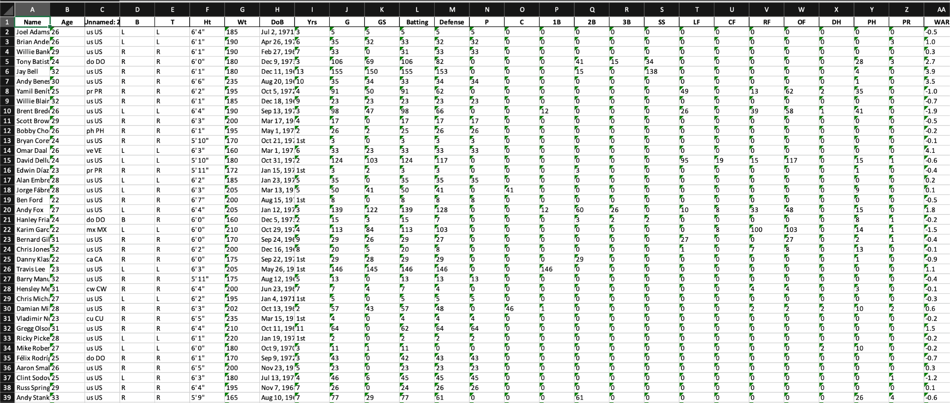
MLB Team Information
We built a custom web scraper that scrapes information for all MLB baseball teams from baseball-reference.com
The scraper scrapes all relevant statistics, including wins, losses, and the WAR.

Slide 6
03
The Platform

Slide 7
“What’s your PC specs?”
Hardware:
CPU: Intel Core i9-12900k.
Ram: 64gb (2x32GB) of Corsair Vengeance RGB PRO DDR4 3600MTs.
MOBO: ASUS ROG Strix Z790-A Gaming WiFi D4 LGA1700(Intel 14th& 13th & 12th Gen) ATX gaming motherboard.
PSU: Corsair RM1000e (2023) Fully Modular.
GPU: EVGA GeForce RTX 3090 FTW3 Ultra Gaming, 24GB.
Storage: 4x 2TB Samsung 980 Pro SSD NVMe Gen 4 M.2.
Software:
IntelliJ PyCharm Ultimate 2024.3.5, Microsoft Power BI Premium, numpy, pandas, matplotlib, sk_learn, and seaborn.

Slide 8
04
The Model

Slide 9
What Are Baseball Metrics?
Original baseball statistics were: AVG, OBP.
AVG: Average = Hits / At Bats.
OBP: On-base percentage = times on base / plate appearances.
1984, slugging statistic (SLG) was created.
Was more comprehensive as it weighted the type of hit.
SLG: Slugging = (1×Singles)+(2×Doubles)+(3×Triples)+(4×Home Runs) / At Bats
Ex: SLG = 1.000 means a batter averages 1 base per At Bat.
These stats are shown as a “slash-line” AVG/OBP/SLG.

Slide 10
Why Advanced Metrics?
Goal is to add more context to statistics.
Most advanced metrics are represented with a + at the end.
League average is 100.
EX: OPS+ = 150 means 50% better than league average.
OPS: On Base + Slugging = OBP + SLG
Representation of how often someone gets on base + how many bases they get.
OPS+: Weighted OPS = 100 x (OBP/lgOBP + SLG/lgSLG - 1).
Adjusts for factors like location and pitcher-faced to normalize statistics.
EX: More home runs in Denver due to elevation.
Plus metrics for every statistics.

Slide 11
Landing On WAR
WAR: Wins Above Replacement
Measures how much better a player is (in terms of wins) compared to if they were replaced by a league average player.
Comprehensive statistic (includes all stats at a weighted average).
Calculate wOBA to calculate wRAA, to calculate WAR.
Formula Broken Down:
wOBA: Weighted on-base average
wRAA: Weighted runs above average
AB: At bats
BB: Bases on balls (walks)
IBB: Intentional bases on balls
HBP: Hit by pitch
P_{Runs}: Player runs
A_{Runs}: Average runs
SF: Sacrifice flies
1/2/3B: Base reached
HR: Home run
SB: Stolen base
CS: Caught stealing
⍶: Coefficient for statistical formula (weights)
R_{Runs}: Replacement level runs

Slide 12
05
The Results

Slide 13
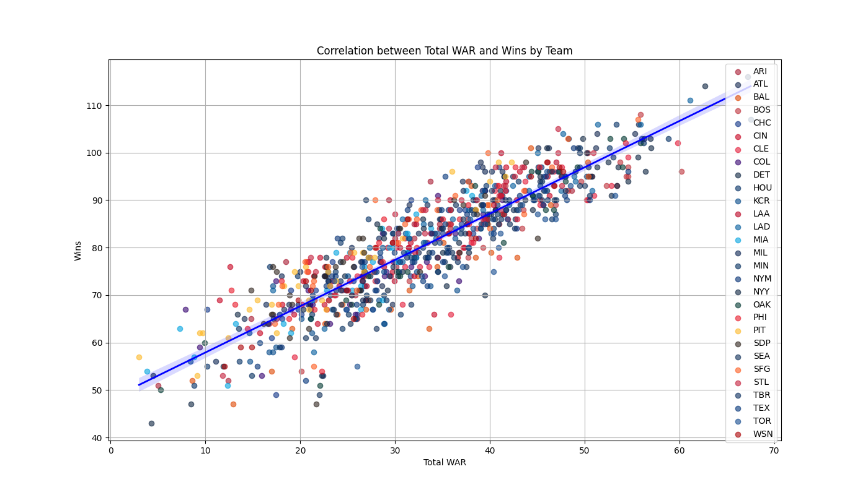
Predicted 2024 Statistics of a MLB Team
Model Metrics:
R2: 0.818 - Good
ME: 0.198 - Very Good
MAE: 4.193 - Not Satisfactory
RMSE: 5.474 - Not Satisfactory
NSE: 0.818 - Very Good
PBIAS: -0.243 - Very Good
RSR: 0.427 - Very Good
R2: Coefficient of determination
ME: Margin of error
MAE: Mean absolute error
NSE: Nash-Sutcliffe efficiency
PBIAS: Percent bias
RSR: Root Mean std ratio
Predicted Record based on WAR of 35: (82, 79, 0)

Slide 14
06
The Code

Slide 15
Coding the ML Model
Scrape baseball-reference.com
Since MLB data isn’t publicly accessible via an API (without paying obscene amounts of money), we scraped data from the website. More specifics can be found on the README.md on our GitHub repository.
Data load and clean
Used pandas DataFrame to read all XLSX in our data folder. We ignored all null and NaN values for all operations (since not all players play every position).
Data preprocessing
Loaded WAR column into pandas DataFrame for each team and season.
Model training
Trained using linear regression and metric values at a 95% CI.
Predictions
Used ML linear regression model to make record predictions based on teams WAR.

Slide 16
07
The Conclusion
LINK TO GITHUB

Slide 17
Thank you for listening!
Our model demonstrated strong predictive capabilities (R^2 = 0.818).
Good because it shows approximately 81.8% of the variance in our dependent variable (team performance) is predictable from the independent variables .
Noteworthy in the context of sports analytics, where outcomes can be highly uncertain and influenced by numerous factors.
Model faced challenges, particularly with the mean absolute error (MAE) of 4.193, which is not satisfactory.
On average, predictions deviate from the actual results by about 4.193 wins, which can easily sway the outcome of any team any given season.
With time and model refinement, Kim Jong Un should be able to successfully rig the baseball games.

